Slide 1
We work in the field of educational tourism and Education.
Our aim is to offer the exciting opportunity to learn through traveling, wherever those travels take them. To take part in, and build on, every opportunity the world presents, to learn and develop skills through experience and nonformal learning. To plant the seed of adventure in every person to nurture a desire to travel to learn, and help them to keep it alive for ever.
Mariví Gracia
Directora

Slide 2
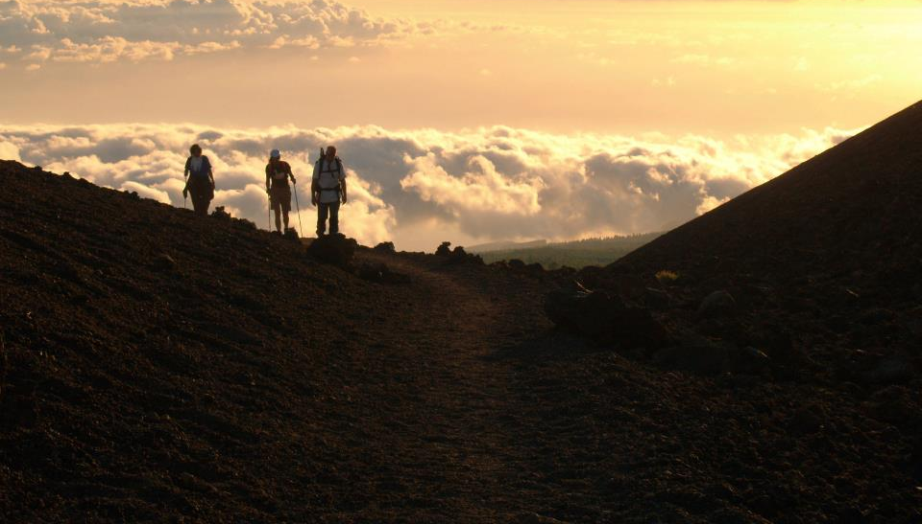
Everyone
has a responsibility
to play a part in their own development,
to want to learn, to be independent, in a changing world.
Cada persona
ha de comprometerse
con su propia formación. Ha de querer
aprender de forma independiente y autónoma en contextos cambiantes.
Viajar para aprender, aprender viajando.
#Traveltolearn #Learnbytraveling

Slide 3
servicios
services
Escuelas y Universidades
Schools and Universities
SERVICIOS COMO EMPRESA INTERMEDIARIA ERASMUS PLUS
Implementación en destino de projectos K1 y K2
Visitas de Estudio
Estancias lingüísticas
Visitas preparatorias para proyectos confirmados
Seguimiento de alumnos en movilidad
Certificación de movilidades
Búsqueda de empresas de acogida
SERVICES AS INTERMEDIARY ORGANISATION ERASMUS PLUS
Implementation of K Action plans 1 & 2
Study Visits
Job shadowing
Preparatory Visits
Training courses
Project developments
Quality host company provider

Slide 4
NOVELEROS EN RUTA
EMISOR DE ALUMNOS
In 2019 our new brand as a sending institution was born www.novelerosenruta.com

Slide 5
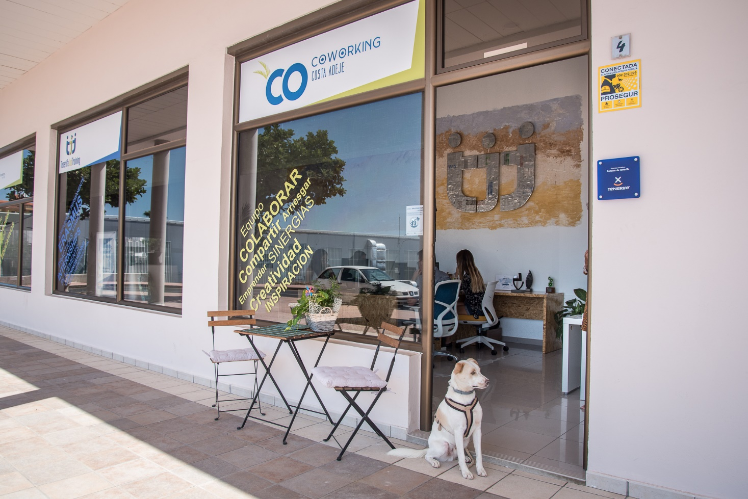
Our latest venture since 2019 is the launch of COCO, Co-Working Costa Adeje, our new shared space perfect for local entrepreneurs and visiting digital nomads! For a daily, weekly or monthly rate, we´re now offering desk and meeting space, wifi, water and coffee services to entrepreneurs and others needing somewhere to lay down their laptop and do business.
Nuestra última aventura en 2019 se llama COCO…. CO-working Costa Adeje. Al instalarnos en las nuevas oficinas de Fañabé, Costa Adeje, en Enero de este año, decidimos compartir nuestras ideas y buen humor con quien se atreva y quiera avanzar a nuestro lado. En nuestra oficina siempre pasa algo nuevo todos lo días. Tenemos espacio para ti, seguro¡¡

Slide 6
BABBATT – Better Adult Training
Michel Cédres:
His story from adult learning to becoming and entrepreneur:
https://youtu.be/VuU9rcVHSsk
“I could never thought somebody could pay me for my passion”
“I suddenly realised that I had mixed two of my passions: teaching and photography”
“If you have a passion, try to find the way to turn it into your job”

Slide 7
www.tenerifejobtraining/professionals.com
https://coworkingcostaadeje.com/
+34 922 711 512

