Slide 1
Time of Changes
Gintarė Černikienė and
Ieva Šimaliūtė-Gaidukevičienė
April 20, 2021

Slide 2
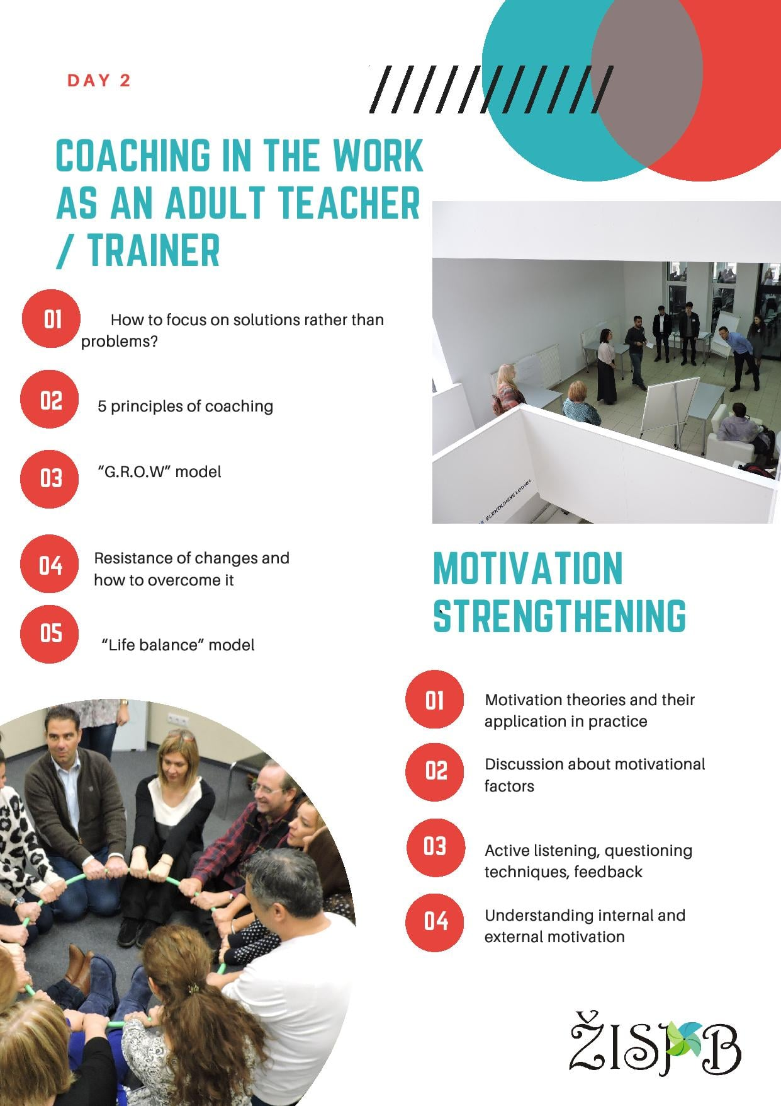
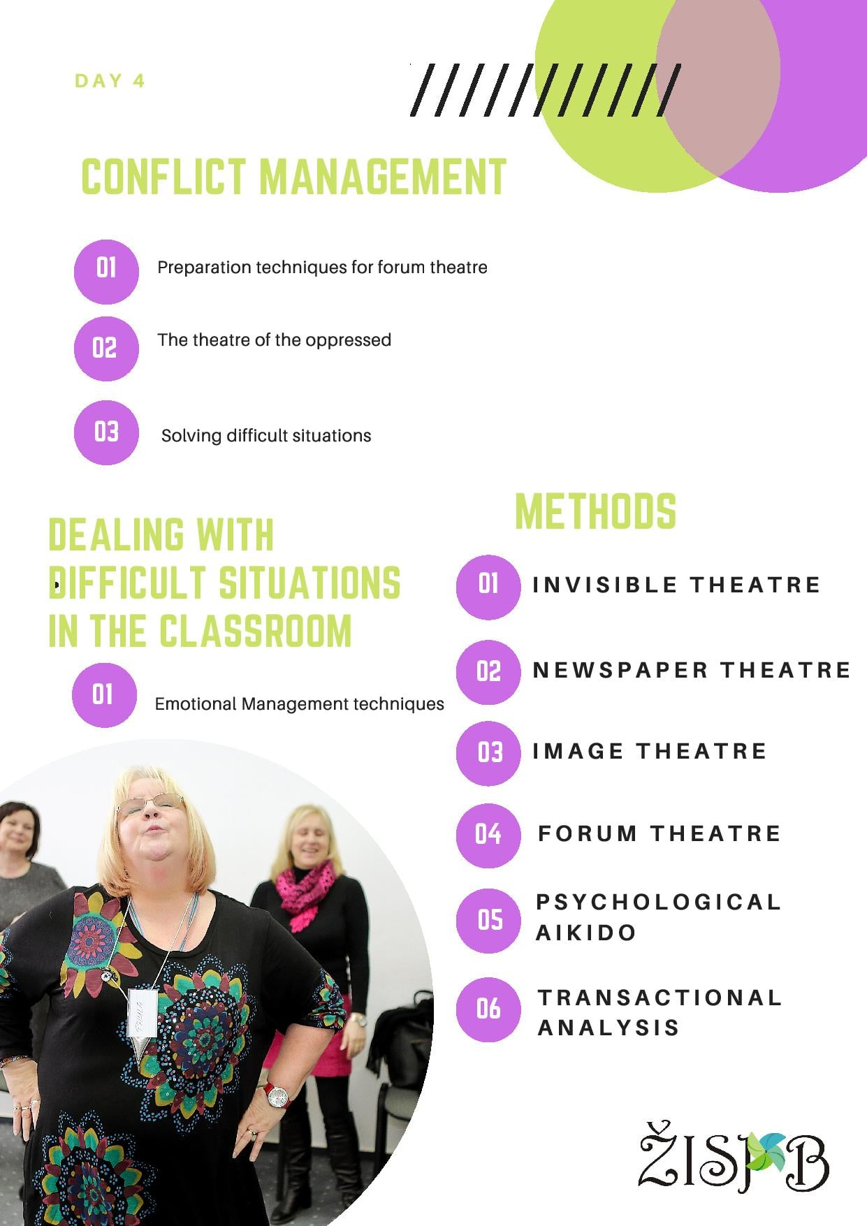
- 2010 - Adult and youth training center - Social and labour intergration of vulnerable people - Erasmus+, NORDPLUS projects - KA1 courses for adult trainers, social workers, etc.
ZISPB (LITHUANIA)
www.zispb.lt

Slide 3
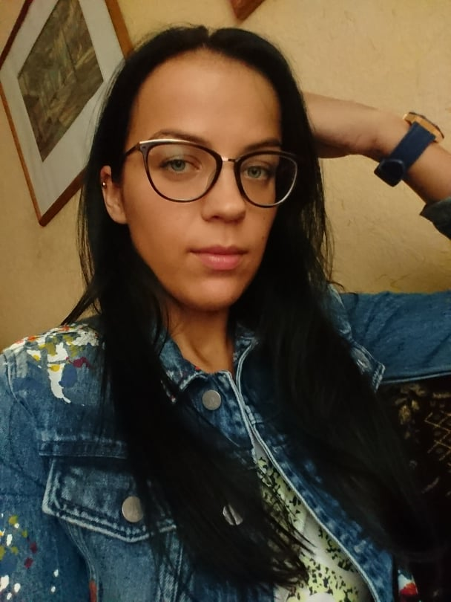
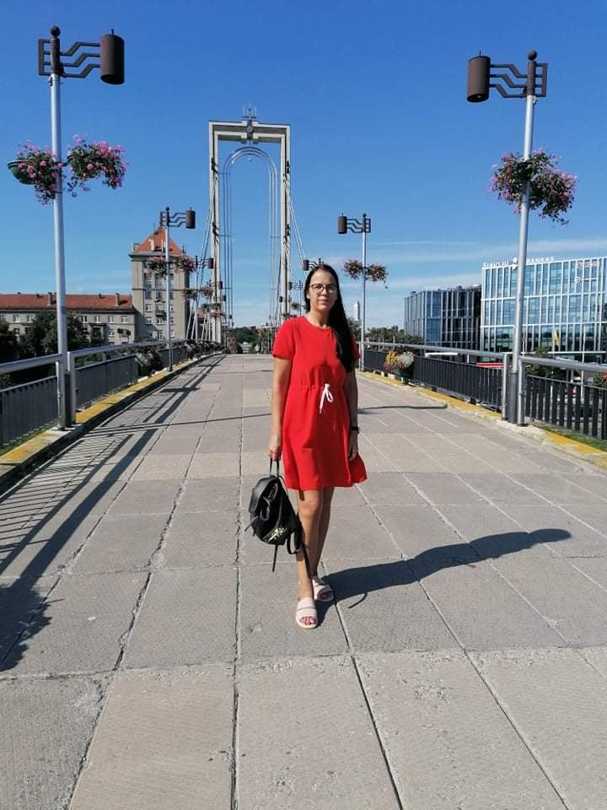
Meet Fausta from Lithuania who with the help of BABBAT project partner VšĮ Žmogiškųjų išteklių stebėsenos ir plėtros biuras is buidling up her confidence, trying to get skills necessary for the labour market and creating better future for her daughter and herself.
Good Practice Example
Lithuania
https://www.facebook.com/115346493340330/videos/331514238147178

Slide 4
Good Practice Examples
Lithuania
Notes:
https://www.youtube.com/watch?v=GkfI0oEfSLI&t=37s

