Slide 2
On-line learning from the point of students’ view and personal experience of students
PhDr. Petr Hercik, Ph.D.
Žofie Vopálenská

Slide 3
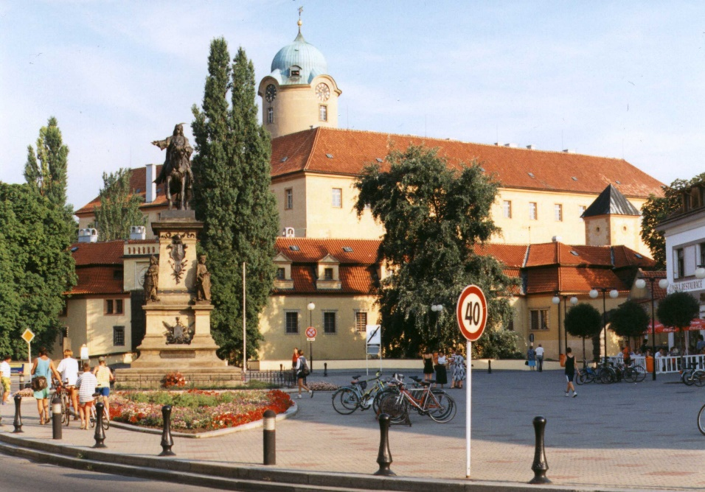
Survey
EKO Grammar School and Secondary School of Multimedia Studies
12 classes
178 respondents
65 questions
Carried out in March 2021
Distance learning

Slide 4
Results
How would you rate the approach of the teachers as a whole?

Slide 5
Results
Is communication from teachers’ side within distance learning sufficient?

Slide 6
Results
Which form of teaching suits you best?

Slide 7
Results
How in depth is the material covered in online lessons?

Slide 8
Results
Do you spend more time self-studying within distance learning than during regular classes?

Slide 9
Results
Is the number of online tests optimal?

Slide 10
Results
Do you notice any changes in your results due to distance learning?

Slide 11
Results
Are you facing any mental / physical problems caused by distance learning?

Slide 12
Results
Is the quality of your work improving or do you feel that you are not making progress in any way?

Slide 13
Conclusion
Most students are satisfied with the way distance learning is set up at our school.
They consider the scope of study and the number of assigned tasks to be optimal.
But they are well-aware of distance learning limitations.
Students feel that they didn’t as benefit from distance learning as they would in regular F2F classes and they are worried about their further development.
They are beginning to be demotivated, even towards further studies.
On the other hand, they have greatly improved in their ability to self-study – an integral part of lifelong learning, the necessity of which they will realize very soon.

Slide 14
Thank you for your attention.
-- PhDr. Petr Hercik, Ph.D. EKO Gymnázium a Střední odborná škola Multimediálních studií Poděbrady Na Hrázi 64/III, 290 01 Poděbrady, Czech Republic www.ekopodebrady.cz www.mm4you.cz

