Slide 2
BABBAT ME on-line conference April 20, 2021
Czech team
Work on O1
Value added to 01 in Covid-19 times
PhDr. Eva Svobodová
EKO Grammar School and VET School of Multimedia Studies Poděbrady, Czechia

Slide 3
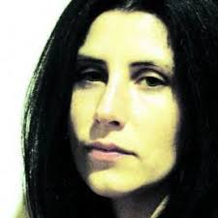
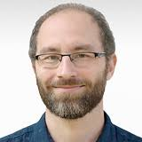
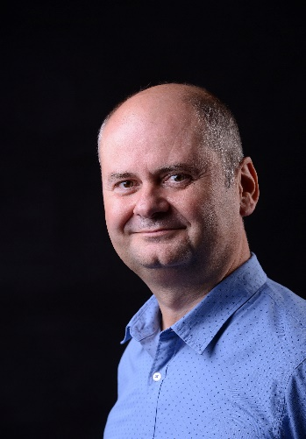
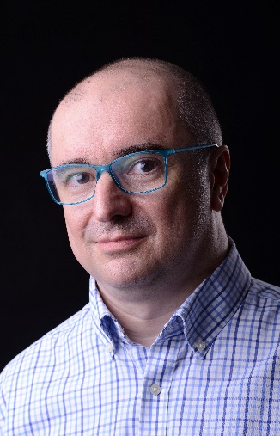
BABBAT ME on-line conference April 20, 2021
CZECH TEAM
Eva Svobodová
Kateřina Zumrová
Aleš Bezouška
Leona Kubišová
Monika Martínková
Šimon Chloupek
Radek Stýblo
Petr Hercik

Slide 4
BABBAT ME on-line conference April 20, 2021
O1 = Motivation + Best Practice Example + Focus Group
Goals:
To map the situation in partner countries
To find motivating examples in career start-ups
To learn and share from experts
Czech team role:
To supervise all submitted materials
Create O1 design – simple, clear, easy to read

Slide 5
BABBAT ME on-line conference April 20, 2021
Ad Motivation
Researches and consultations necessary
Advantages and hindrances
Best Practice Examples:
English and national language versions (photos and videos)
Heroes to follow
Focus Group: Experts, consultants and supporters
https://www.ekopodebrady.cz/ekogymnazium/o-skole/projekty/bob-as-bait-better-adult-training/

Slide 6
BABBAT ME on-line conference April 20, 2021
21st century - education IS NOT the attribute only to children and young people
Changes on many levels in many commodities lead to LLL and education
Low skilled at the labour market – where from?
The impact of unified maturita – more demanding tests more difficult for students at VET schools
Low skilled adults recruited from drop-outs

Slide 7
BABBAT ME on-line conference April 20, 2021
No doubt that educated staff/workers
with acquired knowledge and skills get easier to interesting, usually better paid jobs
with higher probability find a job or start a new career, sometimes a new business
have stable income ensured
feel more in control of life.

Slide 8
BABBAT ME on-line conference April 20, 2021
Hindrances?
requalifying courses may be time-demanding and expensive
not enough information about potential upgrading courses
mistrust in efficiency of self-education (esp. with seniors)
poor or missing language and IT skills
lack of motivation which is very close to laziness, no ambitions as priorities are family-children-job-relaxation
low motivation as the social benefits are generous

Slide 9
BABBAT ME on-line conference April 20, 2021
Project value added in Covid-19 times:
Many bankruptcies and job losses
Urgent career restart
To encourage, not to give-up
Educators in the process of upskilling are not teachers but life-long learning guides who
ensure that the educated feel their future skills and knowledge will be useful,
motivate the educated to self-responsibility in reaching news skills and knowledge.

Slide 10
BABBAT ME on-line conference April 20, 2021
From the government it is expected:
to create networks among employers, companies, public authorities and educational institutions
to support regional and global partnership,
to focus on development of skills needed for useful, successful and satisfying career in the digital age
to use technologies for the public self-education (MOOC).
BABBAT as the first step for new beginnings
There are two „pushes“ to motivations. Firstly, it is the internal need of individuals, their ambitions and interest in personal and professional growth. Then there is external pressure, when individuals are lead by circumstances. In real life both are combined. For well functioning motivation individuals must see that their efforts are meaningful.
Mgr. Jiří Holý, VISK

Slide 11
BABBAT ME on-line conference April 20, 2021
BABBAT is the first step for new beginnings at the labour market
For those who will to be
and know they are

